Slide 1

Capstone Project
Covid-19 Spread and Predection

Slide 2
Data Source and Data Acquisition
The data set is retrieved from the web location:
https://covid.ourworldindata.org/data/ecdc/total_cases.csv
The data properties are as follows:
Data is a CSV file.
Data contains details about:
Data.
Countries in the world
Number of cases in the same date in each country
Total number if cases in the world

Slide 3
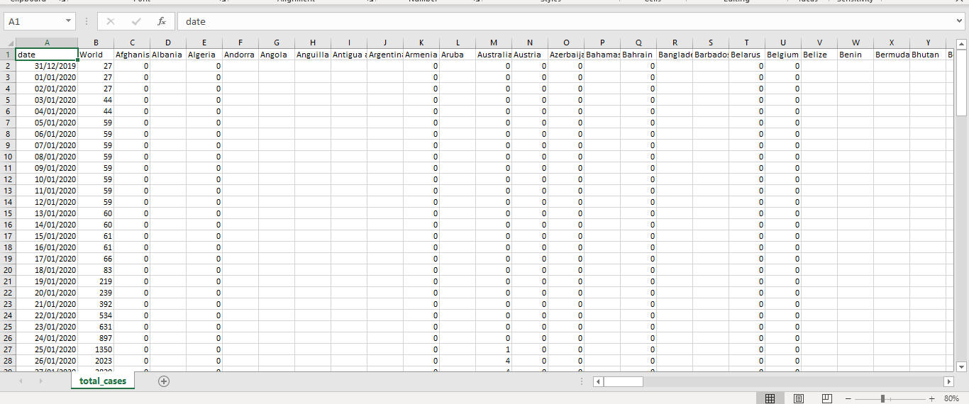

Slide 4
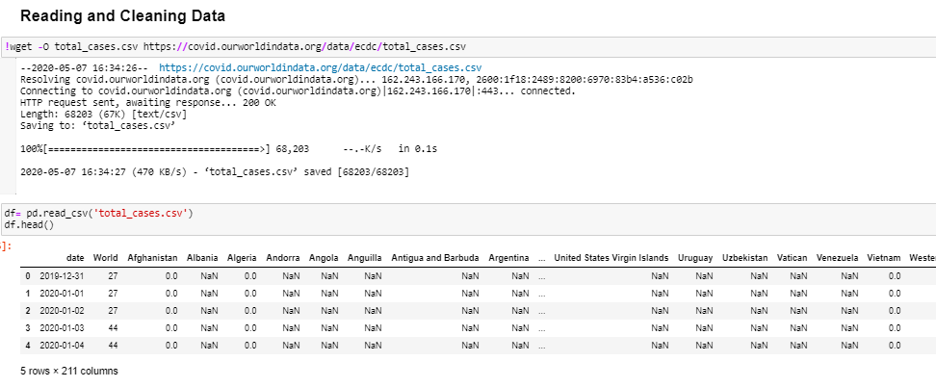
Reading Data

Slide 5
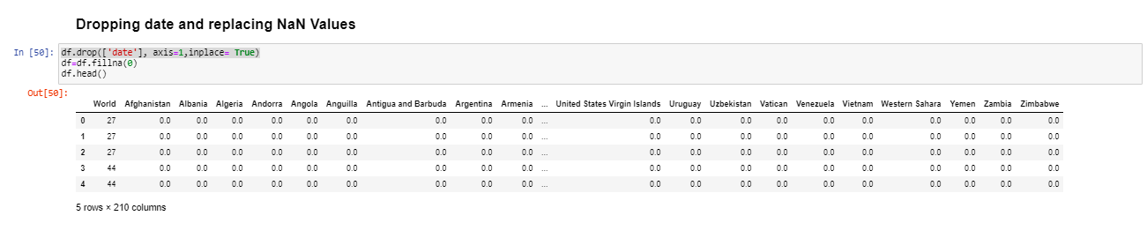
Data Cleaning and Formatting
NaN data are replaced with Zeros “as they represent no registered cases”.
Date is dropped as we are interested in data order rather than the actual date itself.

Slide 6
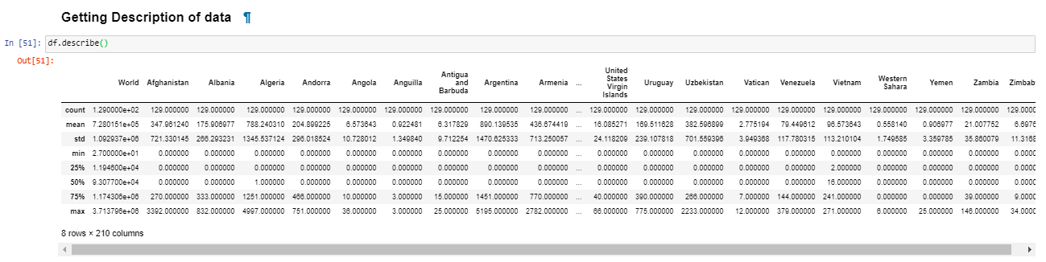
Description about data is found

Slide 7
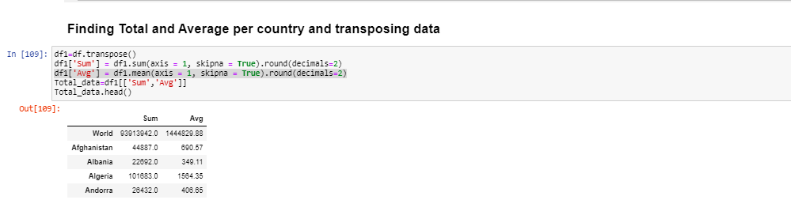
Total cases per country is found, and Sum and Average were found

Slide 8
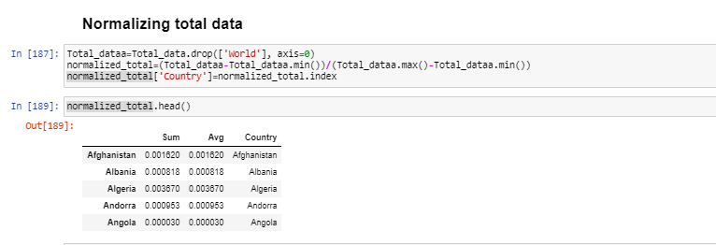
Data is normalized

Slide 9
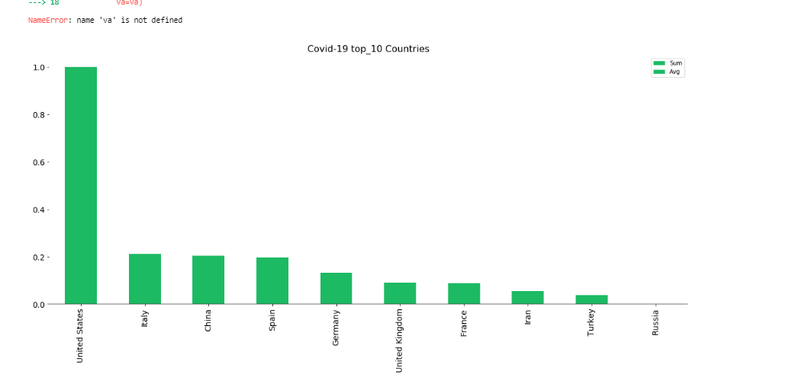
Data Visualization and Exploration
Bar Chart

Slide 10
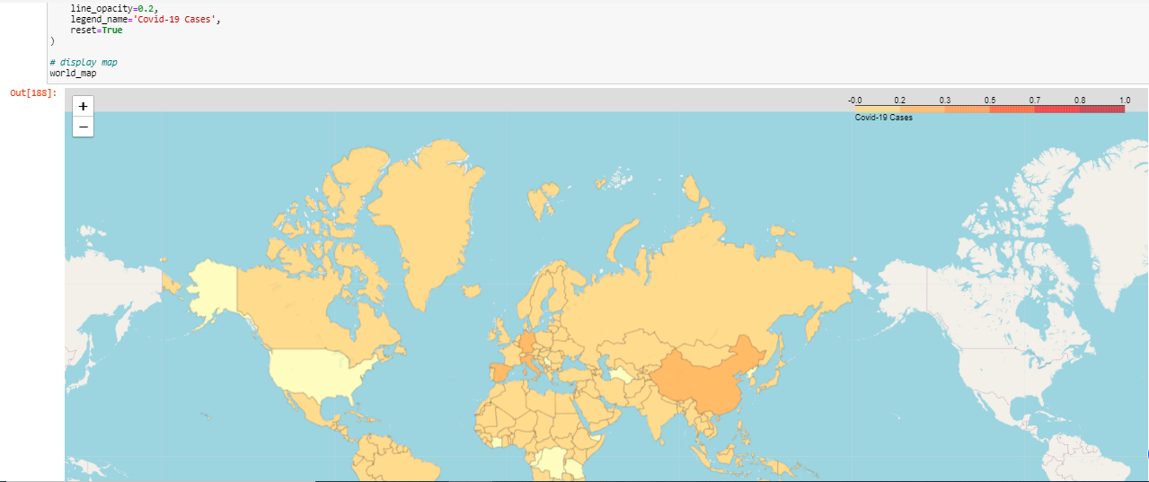
Choropleth Map

Slide 11
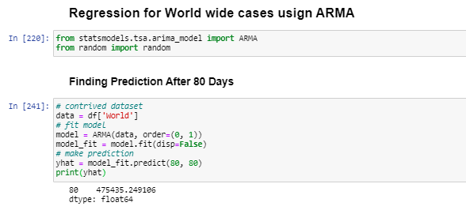
Modeling and Regression
(ARMA) Autoregressive–moving-average model was used to build a regression model for predicting number of cases in the world based of the history for the previous days. ARMA is a statistical analysis of time series technique, autoregressive–moving-average (ARMA) models provide regression based on time series.

Slide 12
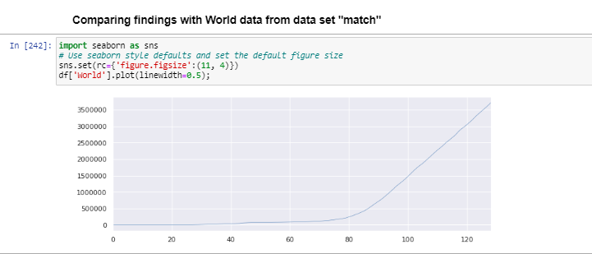
Results
Predicted results were compared with the actual results form data set and a good match was found.

Slide 13
Discussion and Conclusion
Several techniques can be used to provide more readable results when visualizing spread of the Covid-19, for instance Choropleth maps and heat maps can show worldwide, or county-based distribution, while bar graphs can show ranking for most affected locations.
Time series can be used to predict the spread of Covid-19 and the places those will be most affected, based on the history provided so far.
Using data science is essential for medical research support, and much more findings can be obtained to support medical researchers.

